Slide 1
RFM CUSTOMER SEGMENTATION
&
ML APPLICATIONS
Sree Yadlapalli
Prepared for WeCloudData Data Science Diploma
April 14th, 2023

Slide 2

CONTENTS
Introduction
Objective
Dataset description
Exploratory data analysis
RFM Analysis(Unsupervised ML)
Supervised ML Application
Challenges
Conclusion and future work

Slide 3
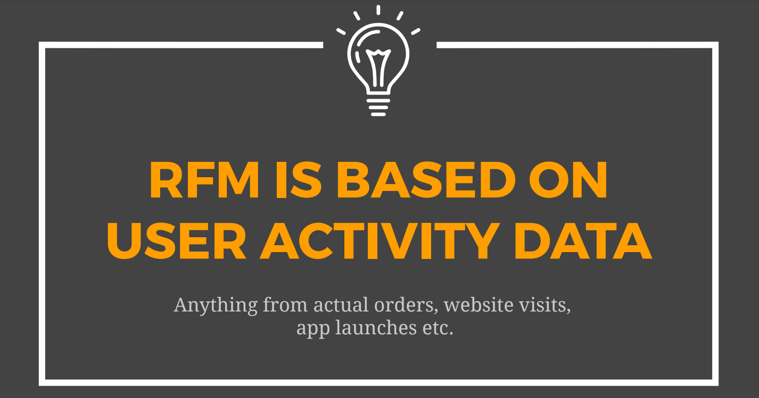

Slide 4
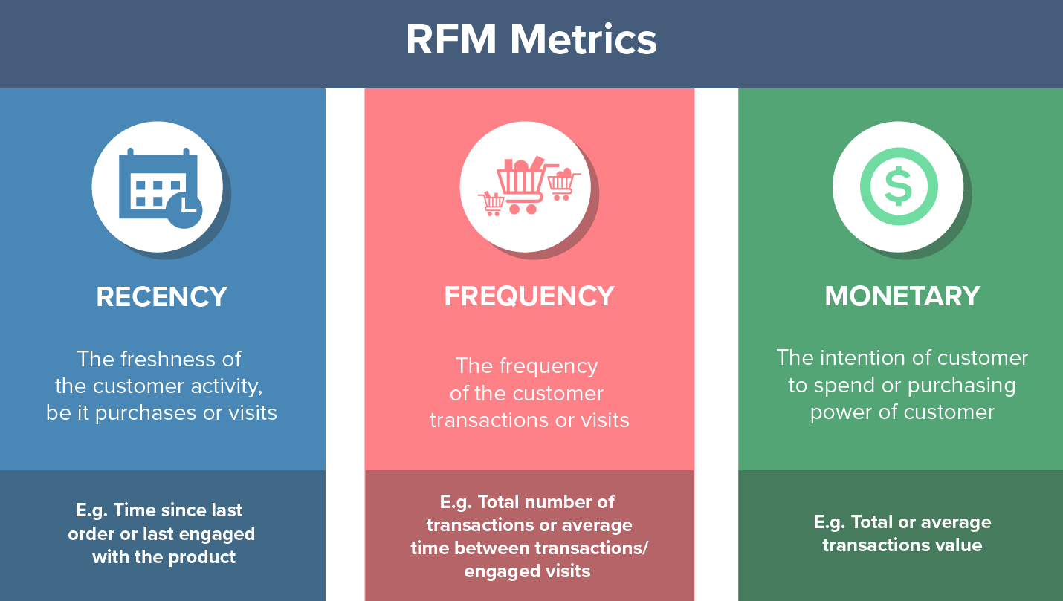

Slide 5
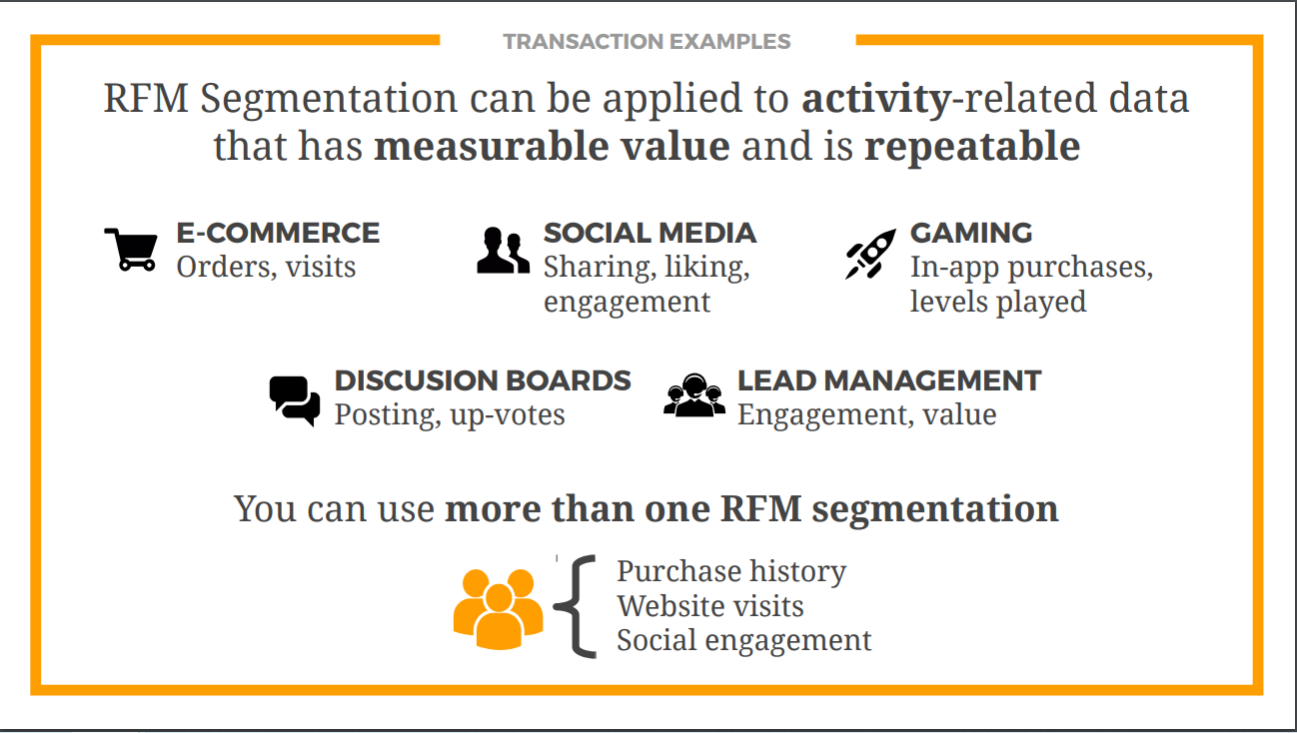

Slide 6
Objective
To conduct RFM analysis on E-commerce sales data.
To establish customer behaviour patterns.
To segment customers according to varying level of engagement and loyalty.
To identify product affinity for different customer segments.
Build a machine learning model on top of the RFM table to predict continuous data.

Slide 7
Dataset Description
Sales Data from an E-commerce company in UK
Over 500,000 rows of data on product purchases
A period of nearly 1-year(December 2010-December 2011)
Eight(8) attributes such as Invoice No., Stockcode, Description, Quantity, InvoiceData, UnitPrice, CustomerID, Country

Slide 8
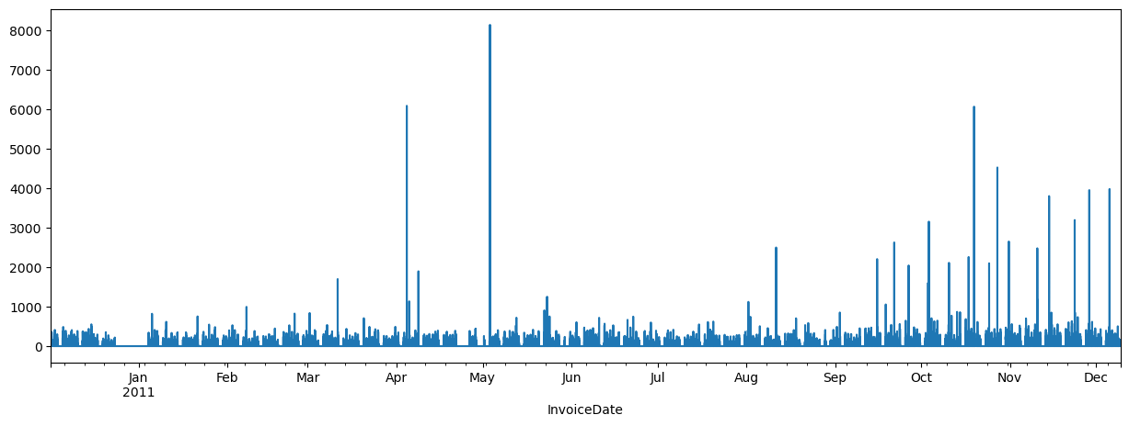
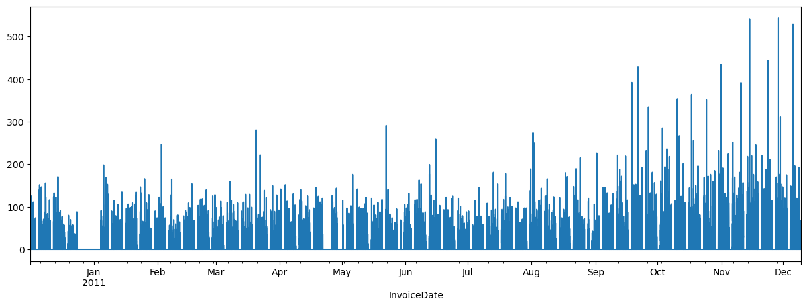
Exploratory Data Analysis(EDA)
Date vs Price
The two graphs illustrates the purchasing trend over a period of year.
Maximum amount of money was spend during the last quarter.
Most number of purchases correlate with the amount spent.
Outlier purchases are seen during the April and May.
Missing data during the month of January 2011.
Purchases
Date vs Count
Count

Slide 9
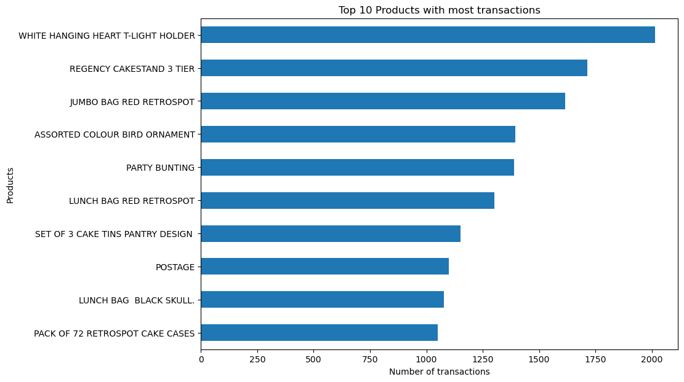
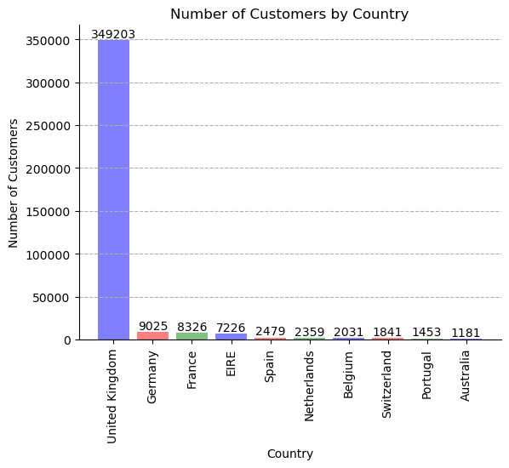
Exploratory Data Analysis(EDA)
Total number of countries in the transactions: 37
Most of the products in the top 10 include home decor items and kitchen utilities.
The customers from United Kingdom brought the highest number of products.

Slide 10
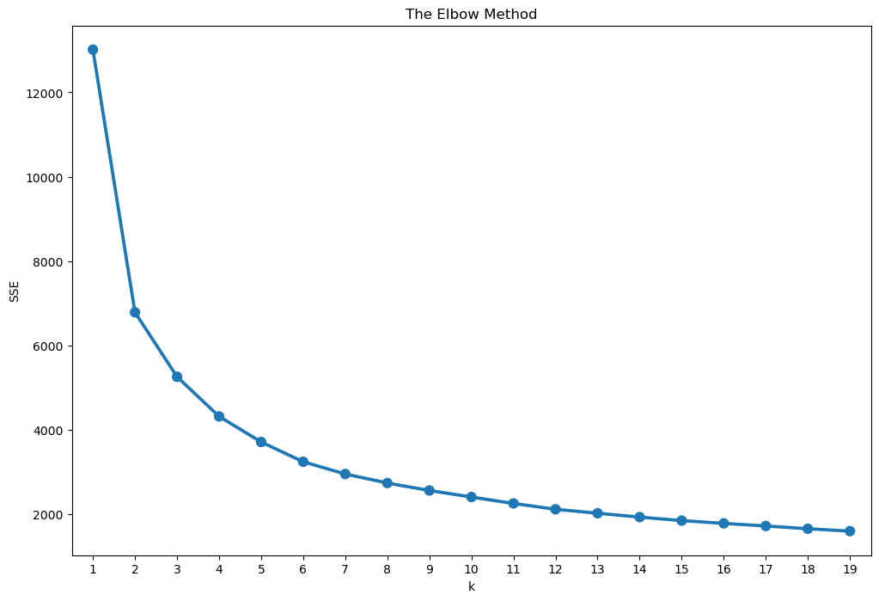
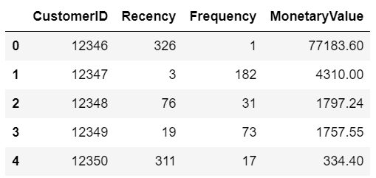
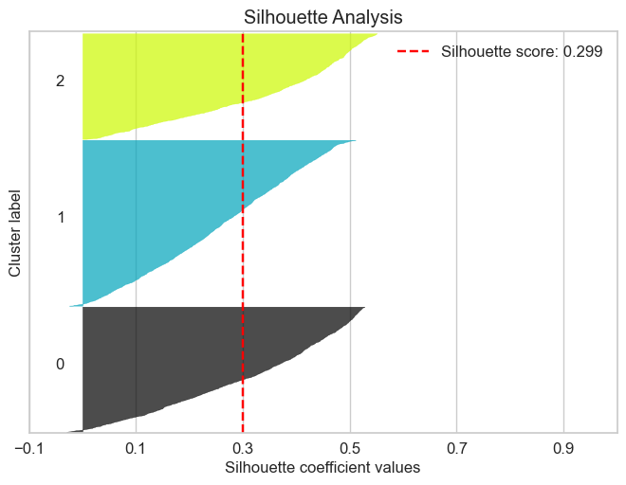
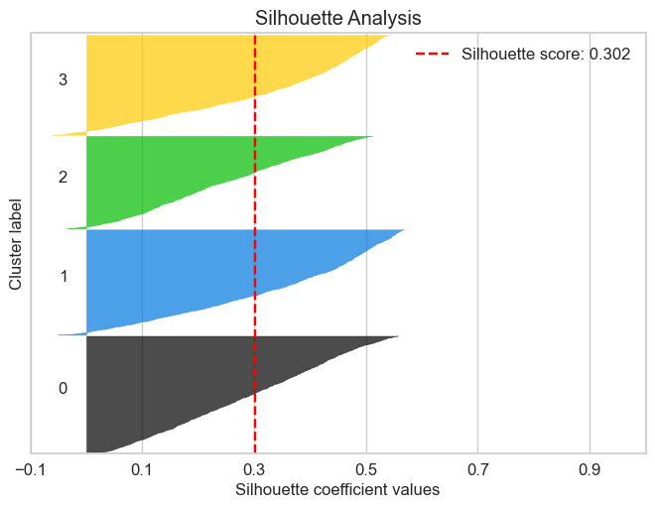
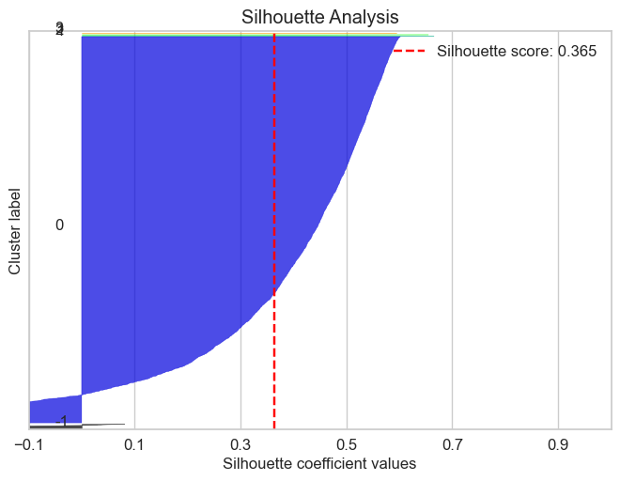
RFM Analysis
RFM Table
KNN Elbow Plot
KMeans(n_clusters=3)
KMeans(n_clusters=4)
DBCluster

Slide 11
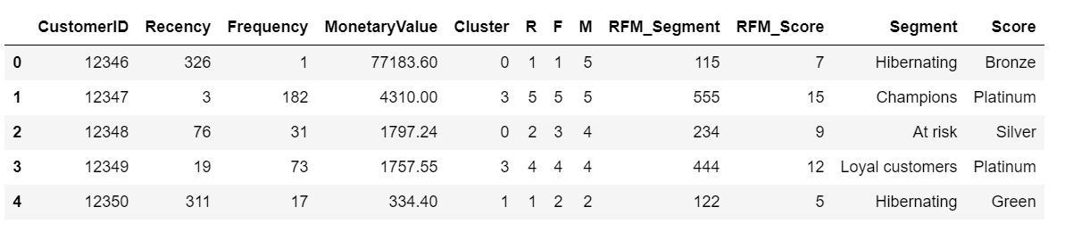
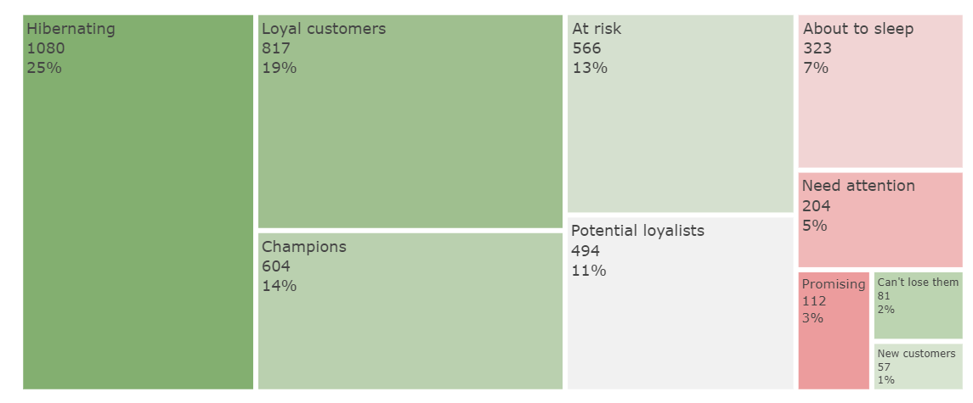
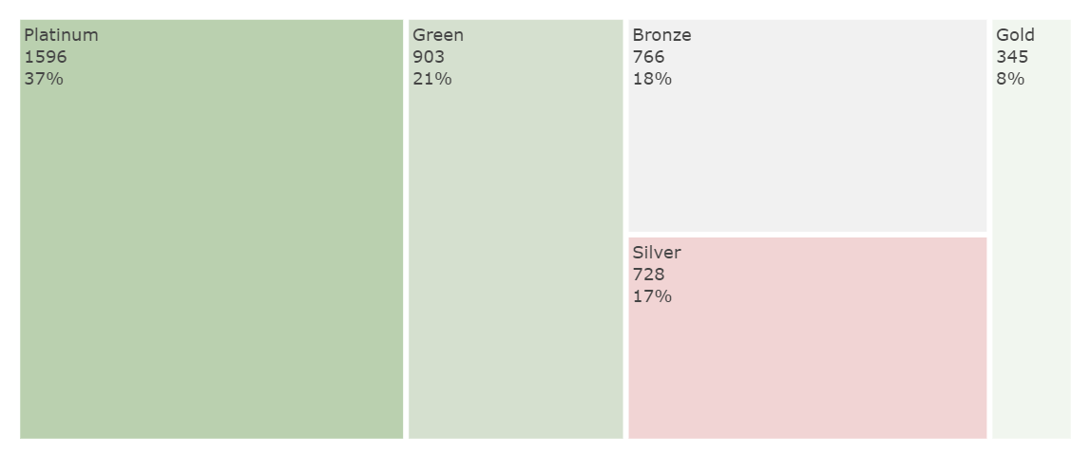
RFM Analysis
Customer Segment
Life time value of customers

Slide 12
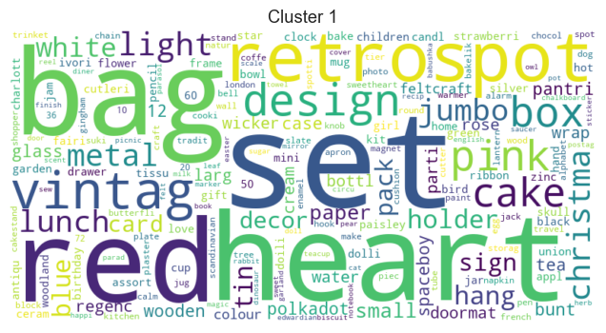
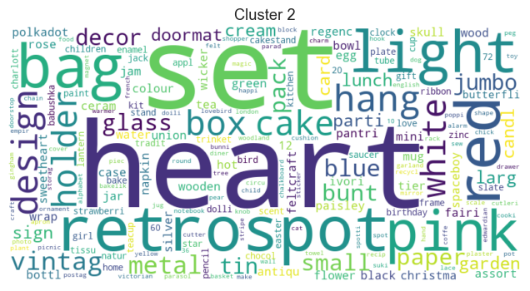
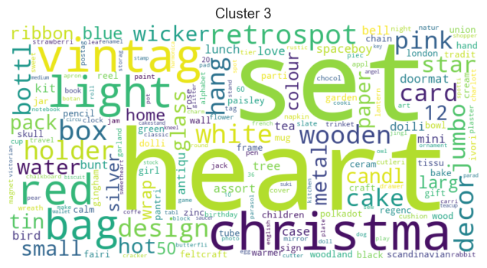
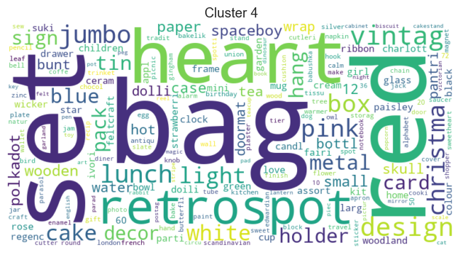
RFM Analysis
At Risk
Churned
Loyal Customers
New Customers

Slide 13
Supervised ML Application
RFM table along with engineered features were used as input.
Entire data constituted a multiclass label classifier.
Correlation factor and Chi Square test were used for feature selection.
Accuracy was used as a primary metric. But Precision , Recall and F1 score are also considered.
4 Baseline models were fitted on the original data
Support Vector Classifier and Logistic Regression resulted in better fit.
Grid Search is applied on the models for best parameters
Both models are fed to an ensemble voting classifier method with hard voting
An improvement in accuracy compared to baseline models is observed.
Model | Accuracy | Fit
Logistic Regression | 86% | Good
Random Forest | 97% | Overfit
SVC | 71% | Good
Xgboost | 98% | Overfit
Sequential | 94% | Overfit

Slide 14
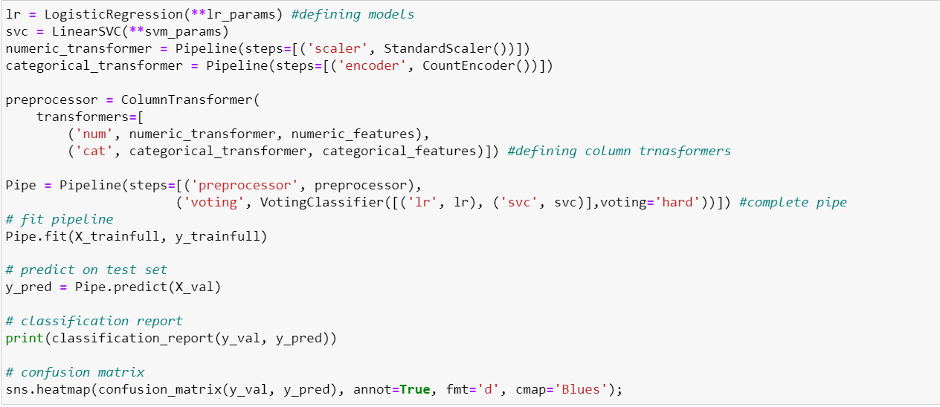
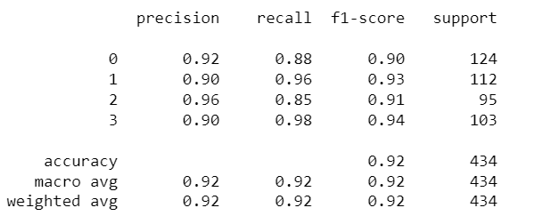
Code on Voting Classifier

Slide 15
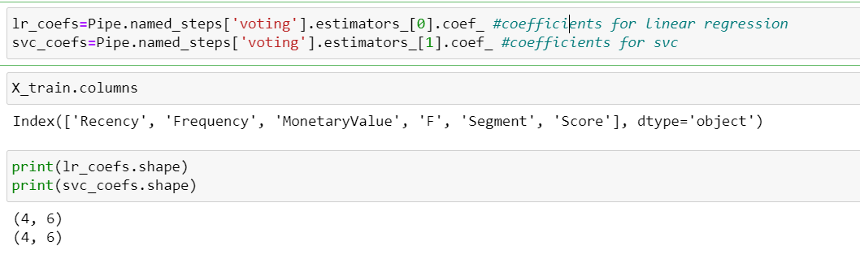
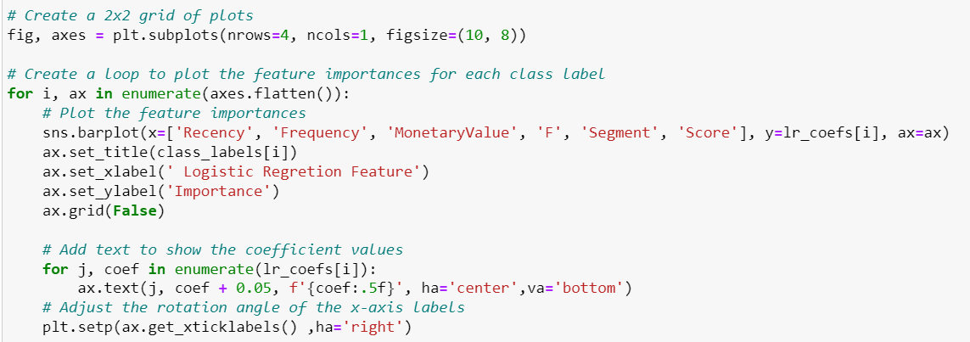
Feature Importance from voting classifier

Slide 16
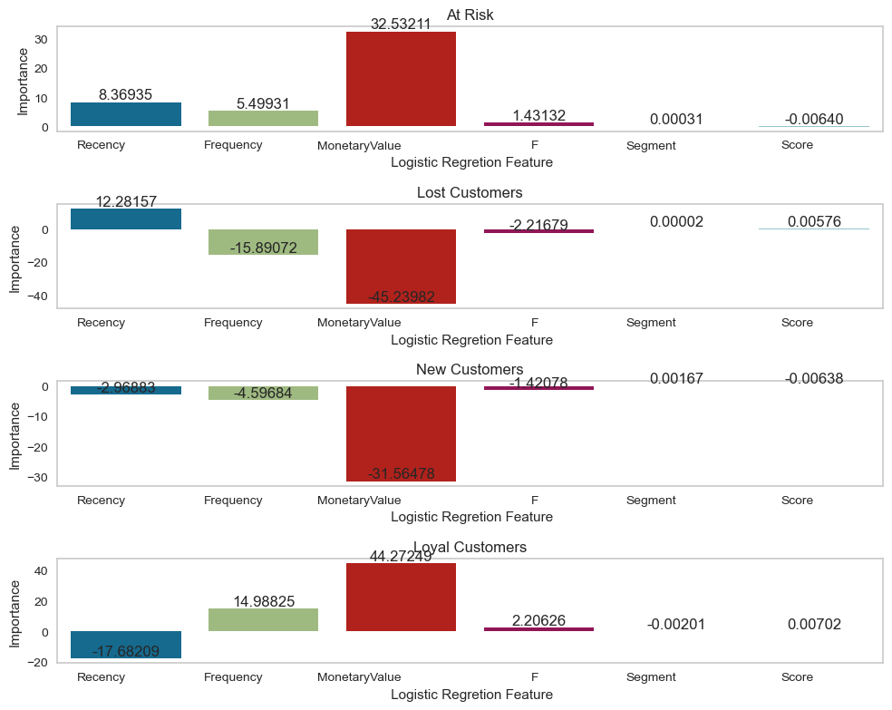
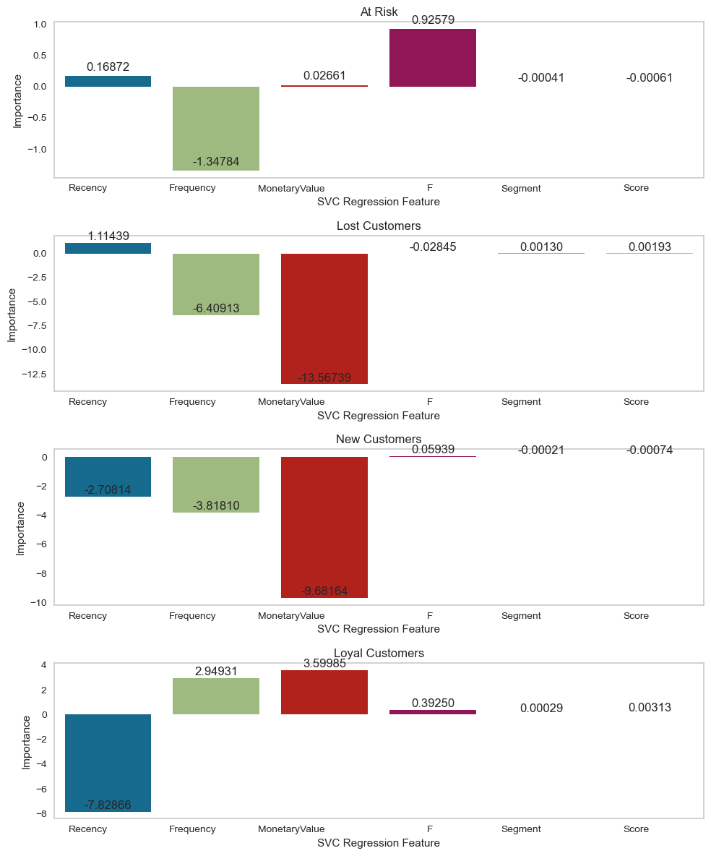
Logistic Regression
SVC

Slide 17
Challenges
500,000 product transactions resulted in approx. 4000 customers.
Understanding feature importance is difficult with ensemble methods.
Need further understanding on hyperparameters.
Lack of extra information(features) regarding the transactions.
The data included the sales of the month of December leading to bias and noise in new customer segment.
Data is not diverse in terms of demography.

Slide 18
Conclusions
The unsupervised machine learning algorithm can effectively group customers based on their purchasing behavior.
By applying the RFM analysis technique, businesses can obtain valuable and advanced insights, such as lifetime customer value and segmentation analysis.
KNN clustering was more effective than DBScan.Data is not diverse in terms of demography.
Voting classifier was able to improve the accuracy of the model.
Future Steps
Perform segmentation with respect to product.
Investigate further on the real-time cluster analysis implementation in different industries.

